Slide 1

“Simpliflyin movie magic for everyone, one screen reader at a time”
Goals
Convenient way to check showtime, reserve seats, and purchase tickets
User-friendly interfaces and streamlined experiences.
Frustrations
Time-consuming and frustrating to navigate through theater websites.
Feel overwhelmed by the amount of information.
Name
Age:
Education:
Hometown:
Family:
Occupation:
30
Computer Science degree
Mexico City, Mexico
Single, no children
Software Engineer
Alex, a visually impaired Latinx. They love going to the movies but often struggle with checking showtimes and purchasing tickets due to inaccessible interfaces. Frustrated by the fragmented experience, they eagerly search for a better app designed with accessibility in mind.

Slide 2
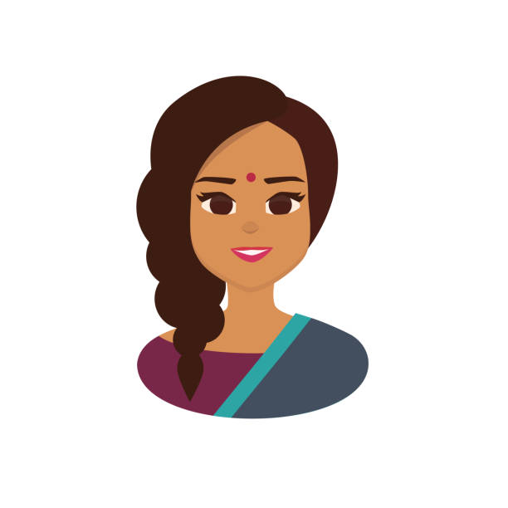
“Bringing smiles to family movie nights, one ticket at a time”
Goals
Easy way to plan movie outings for her family
Find quickly family-friendly movies, check seat availability, and purchase tickets hassle-free.
Frustrations
Struggles with technology and is overwhelming to navigate complex user interfaces
Maya
Maya, a busy administrator officer and mother of two, wants to plan enjoyable movie outings for her family, However, she often feels overwhelmed by the complexities of websites and apps. Maya specifically would like an app’s simple and intuitive design for planning memorable movie nights.
Age:
Education:
Hometown:
Family:
Occupation:
45
High School Diploma
Toronto, Canada
Married with two kids
Office Administrator

